Slide 1
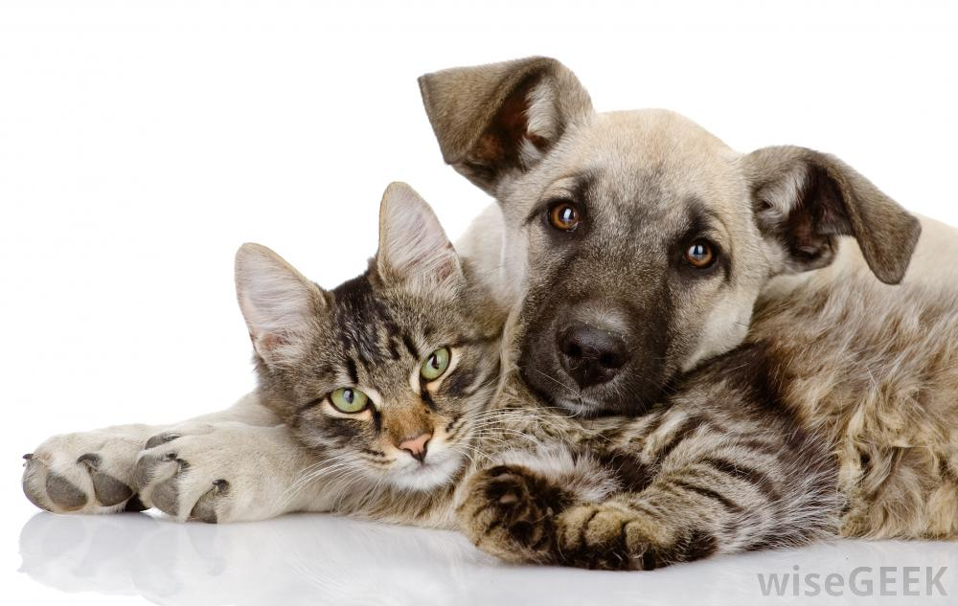
What is different about cats and dogs, and humans ??
By: Emma Grundstrom

Slide 2
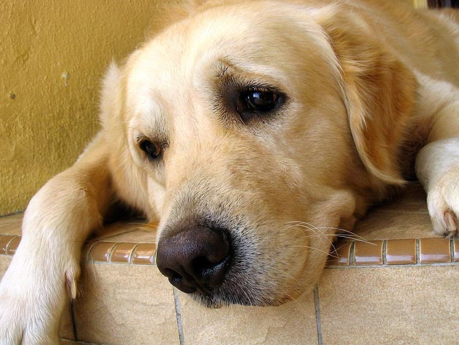
How do Dogs Taste
Puppies sense of taste isn’t fully developed when they are born. There born with only three senses.
Dogs can taste water while humans can’t. Dogs also have taste buds tuned for water, which is also something they share with other carnivores but, its not found in humans.

Slide 3
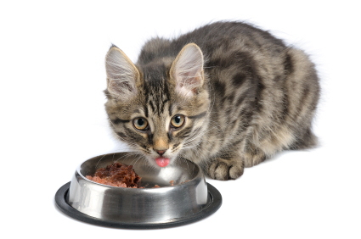
All about cats taste
Cats can’t taste sweets. Scientists do know that cats can taste things we cannot, such as adenosine triphosphate (ATP) Basically they can taste small foods we can’t.
Cats have 473 taste buds

Slide 4
Fun Facts !!!!!!!!!!!!!
Dogs can sense, drugs, bombs, missing people, seizures, and cancer
Dogs chase there tails because of: curiosity

