Slide 1
Stars are a Mystery
By Avery Zeinstra
What are stars, why can we see them?

Slide 2
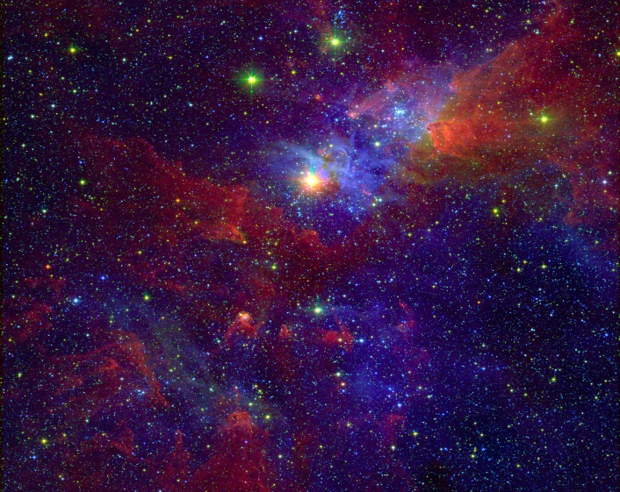
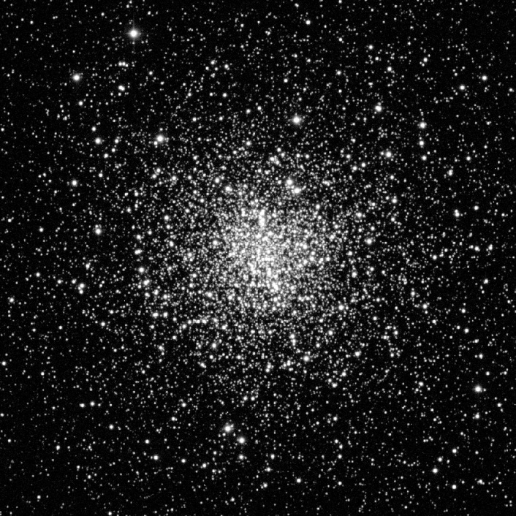
What are Stars?
Stars are big exploding balls made of the 2 lightest gases, 73% hydrogen and 25% helium. A star is formed when hydrogen and helium collapse in space.
Stars have been forming since the universe began. In fact astronomers calculate that five stars form in the milky way each year

Slide 3
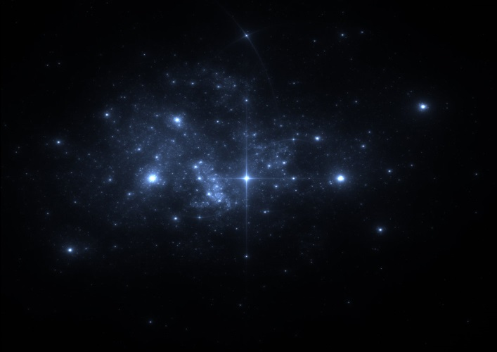
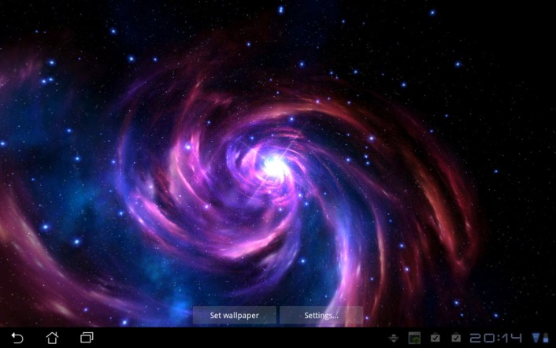
Where can we see stars?
On a clear night our eyes see about 6,000 stars.
The stars are in the sky both day and night. During the day the sun is so bright that we can not see them.
How bright a star appears in the night sky depends on its size as well as how far away from us it is.

Slide 4
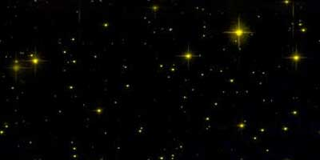
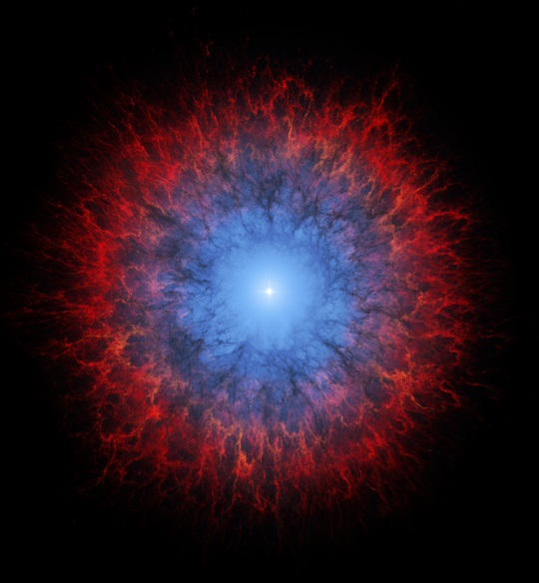
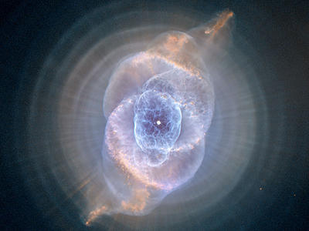
Yellow stars
Like the sun these medium-size stars are yellow because they have a medium temperature. There higher temperature causes them to burn there fuel faster. This means they will only live 10 billion years.
As a yellow star gets older it swells up. After it swells it will deflate and create a gas circle that will surround the star, it is called a Planetary Nebula.

Slide 5
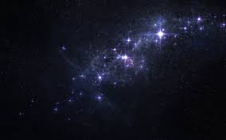
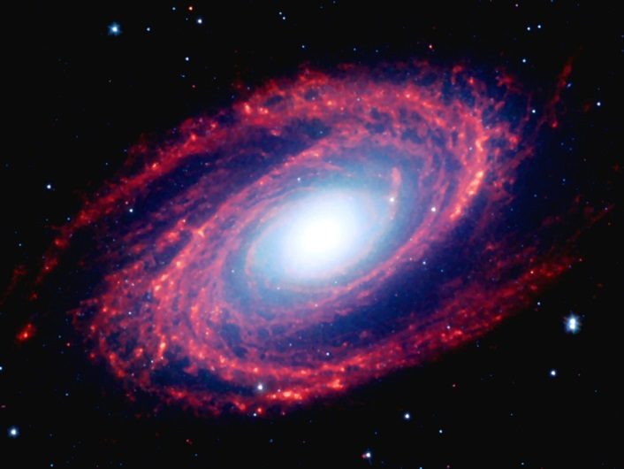
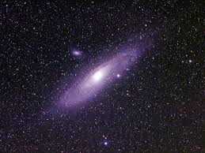
Thanks for watching
Bibliography
Starchild.gsfc.nasagove
Universtoday.com
Kidsastronomy.com
Coolsosmos.ipac.caltech.edu
Qrg.northwestern.edu

