Slide 1


Is The Apocalypse A Myth
In the is story/article you will find out peoples opinions of the apocalypse

Slide 2
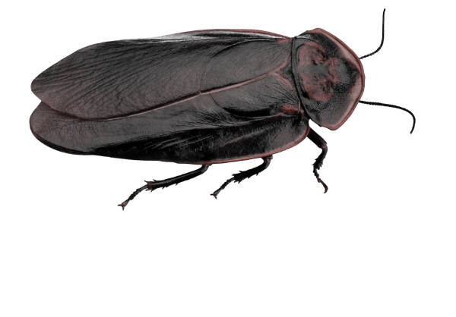
Apocalypse
Many people think zombies can’t rise 6 feet out of the ground, but many other people think an experiment will go wrong and then a disease will go along person by person taking over our body. For example the disease in the new Zombie U called Cordyceps. Right to this day its on insects, but it could spread to humans.

Slide 3
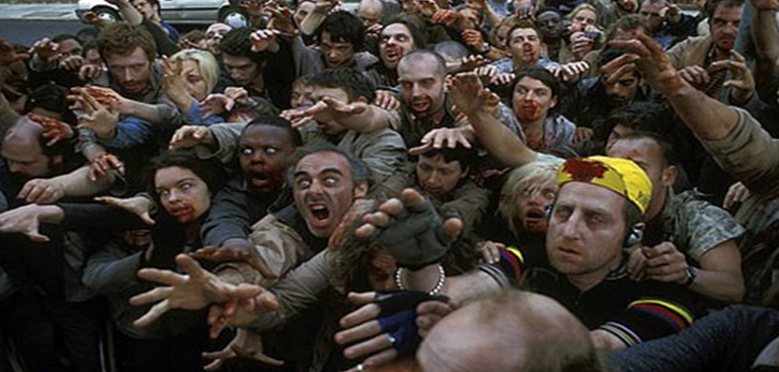
Apocalypse
Zombies
Humans
For instance zombies hissy hiss at you and try to either eat you or turn you in to a zombie.
Humans are all like “How are you today?” and they don’t try to eat you.

Slide 4
Apocalypse
Other people think other creatures will be in the apocalypse including Demons and Headless horse men Plus other stuff I’ll tell you about later right now they also think Centaurs and ghosts.

Slide 5
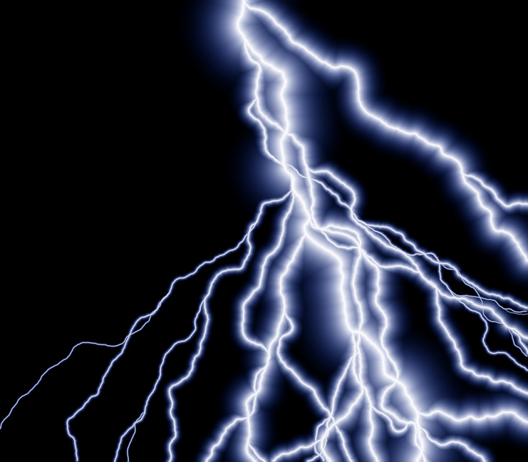

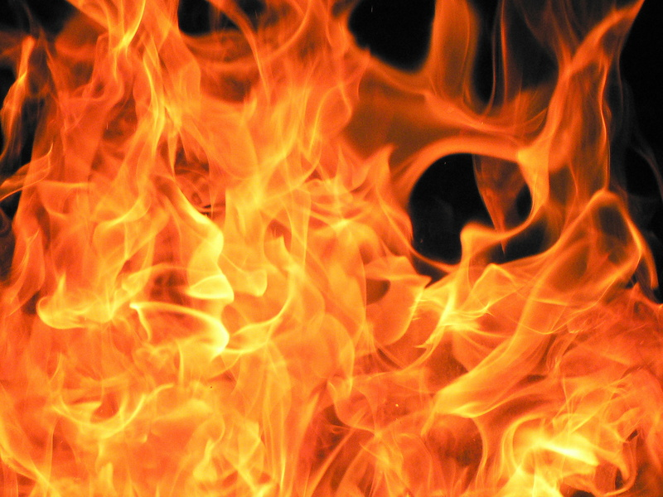
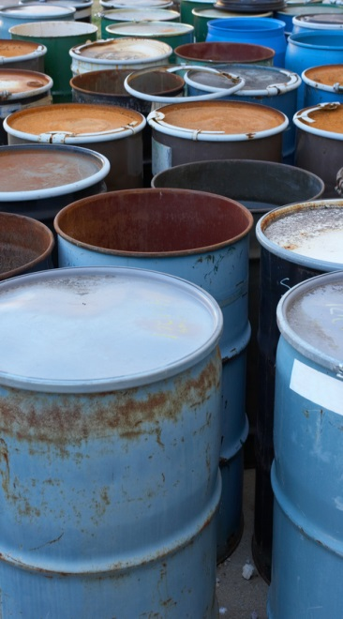
Apocalypse
People think that this so called Apocalypse dragon will return, but when was it ever here? This so called Apocalypse Dragon has the powers of Plants , Lightning , Cold , Metal and Blazing fire.

Slide 6
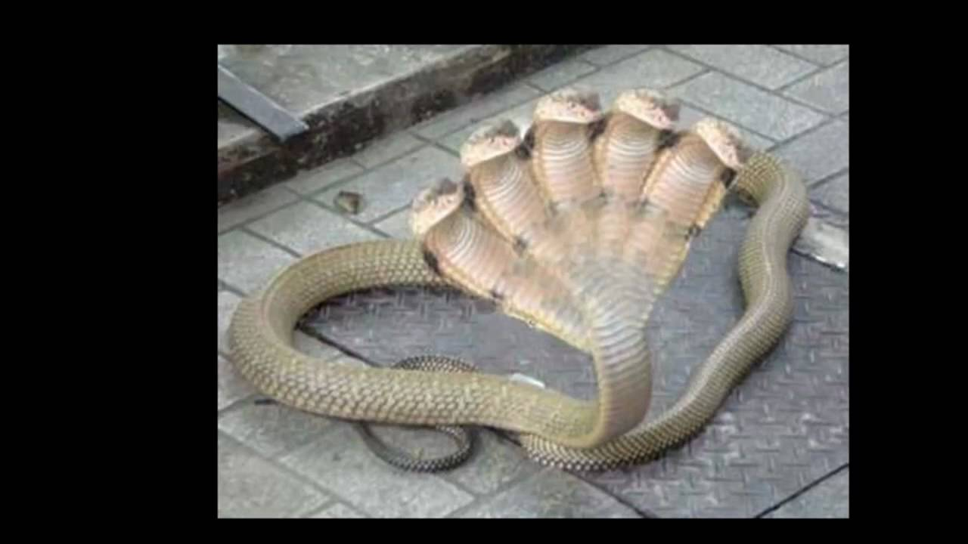
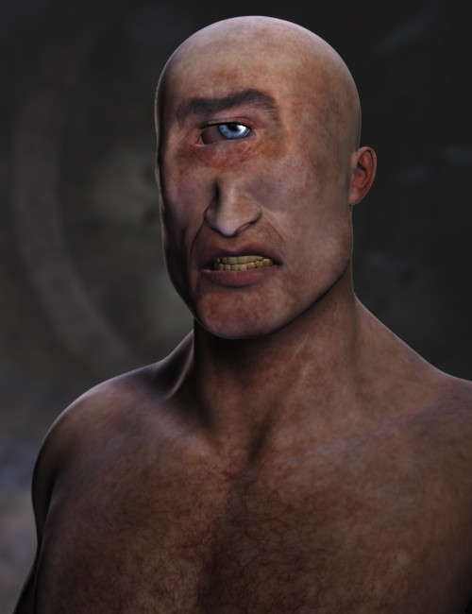
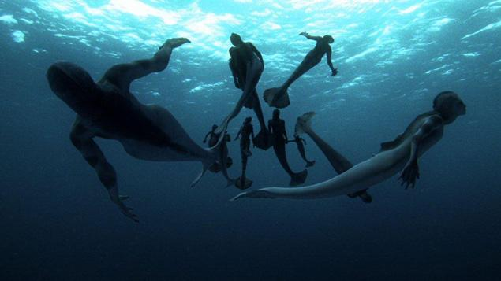
Apocalypse
People think Medusa will be in the apocalypse. Plus other snake like creatures and shark like creatures . Also Griffins , Pegasas , Multiple Headed Serpents , Minetaurs , Phoenix , Mixed Animals , Cyclops , Trolls , Death Mermaids anything from the Flying Dutchman and many more.

Slide 7
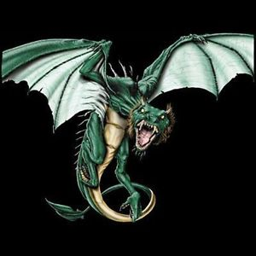
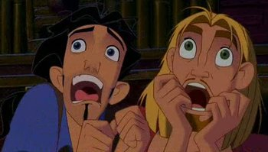
Apocalypse
I looked up people who don’t believe in the stuff of course they said “NO” but I also looked up Greek stuff it said they have been believing their whole life! Now that’s some spirit. And that whoever didn’t believe would suffer when the time is here. If this happens we are all doomed. And maybe the apocalypse will never end since it strikes. Catch you later unless the apocalypse gets you first.

