Slide 1
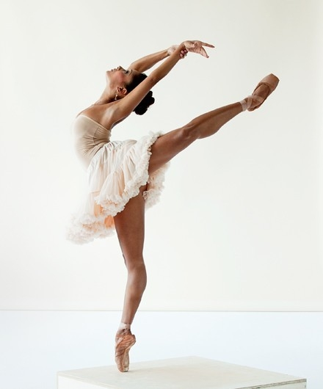
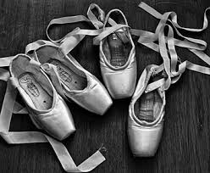
How to become a professional dancer
by: Liz Gillespie

Slide 2
Begin Training
Start training ages 5-8
Find a good dance school
Experience in different styles like, Jazz, Ballet, and Pointe.
Make sure you are dedicated
to dance.

Slide 3
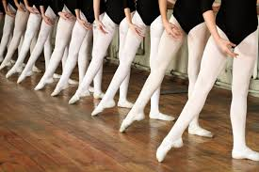
What You Will Need
You will need a good attitude
Also, you will need to be patient
You will need to eat healthy!
Make sure this is what you want to do!

Slide 4
Things You Need To Do
You will need to stretch
Also, keep your confidence!
Practice! Make sure you
keep practicing!

