Slide 1
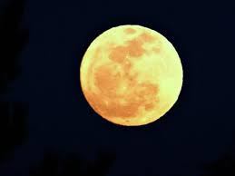
How does the moon affect the earth
http://t0.gstatic.com/images?q=tbn:ANd9GcT2ibKVATEWEP105oha7htPjIlUiVKs9S6I4SIBNUi-Jy1hpwgi:d1jqu7g1y74ds1.cloudfront.net/wp-content/uploads/2013/02/full-moon-japan-580x435.jpg
By James Korreck

Slide 2
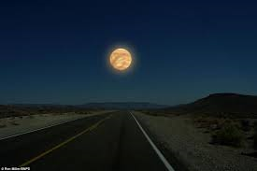

Slide 3
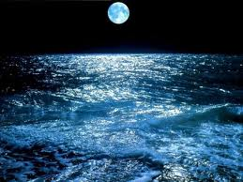
How does it affect the tides
It affects the tides with it’s gravitational pull.

Slide 4
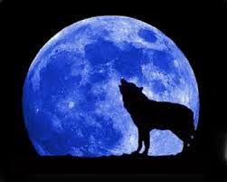
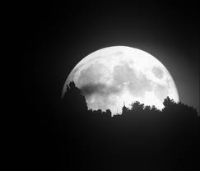
How it affects animals on earth
The moon affects earth animals by the connections they have.

Slide 5
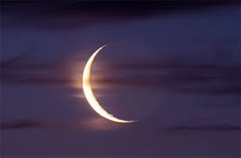

Slide 6
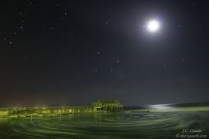
If we had no moon
If we had no moon there would be no difference between high and low tides

Slide 7
What is the moon made out of
Like all bodies of the solar system rock is the most realistic ingredient. The moon’s surface is covered in dead volcanos and impact craters.

Slide 8
The end

