Slide 1
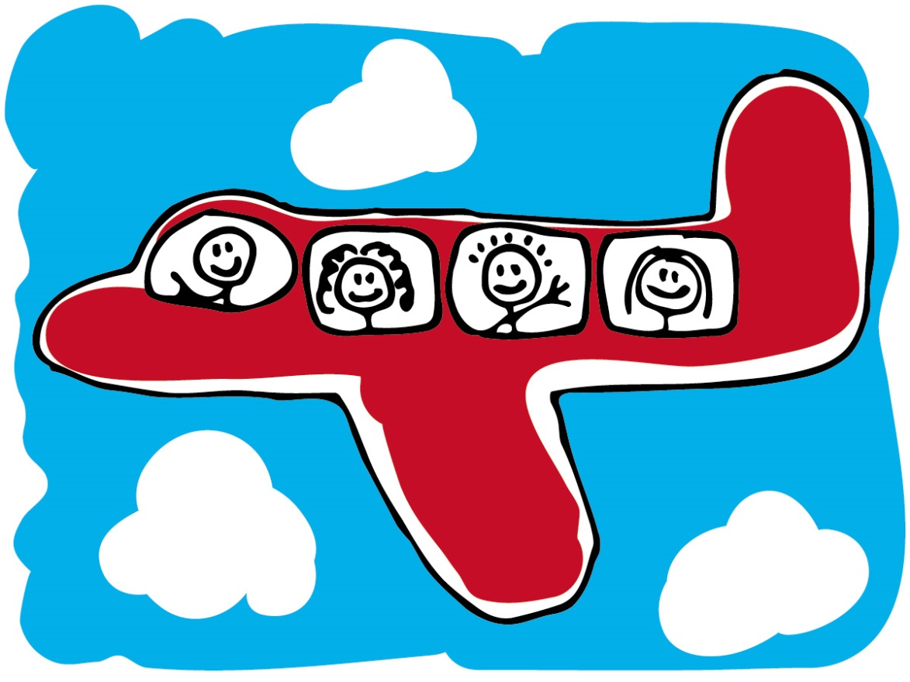
How planes fly
by Gabe predum

Slide 2
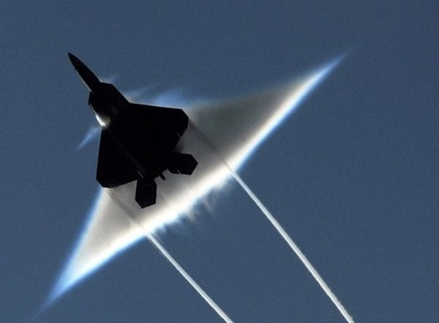
Sound barrier and breaking sound barrier
Sound barriers is smoke from a airplane
When broken a sound barrier makes a sonic boom witch makes the plane fly fast as fast as the speed of sound!

Slide 3
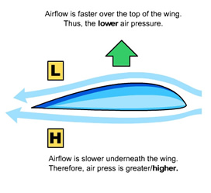
Air flow
The air flow of the plan on is faster on the top and slower on the bottom
The air flow helps the plane fly in the air. This is called lift

Slide 4
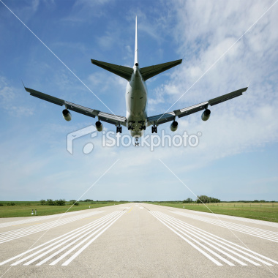
landing
When landing a plane does a 4 step progress: approach, round out; flare, and touchdown
When landing if the plane is to high or to low the plane has to do the 4 step progress again

Slide 5
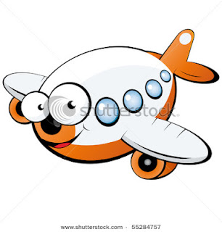
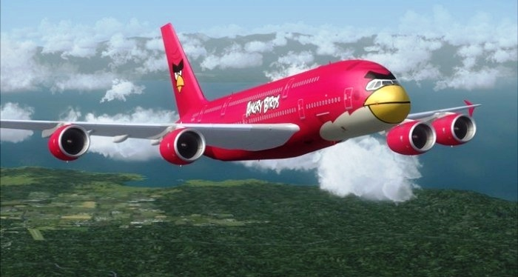
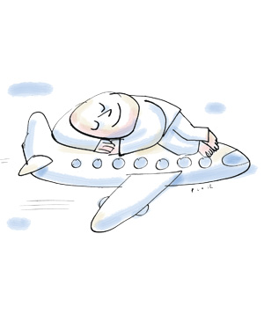
The end

